Slide 1
GitHub Copilot
Dev Days
Notes:
Welcome everyone to GitHub Copilot Dev Days. My name is (Insert name), and I’m so excited to be here this is just one of hundreds of global events that GitHub and the development community partnered with to show off the latest and greatest and agentic development with GitHub Copilot.

Slide 2

GitHub Copilot:
Your AI Companion for Every Workflow
Your Name
Your Company/Socials
Notes:
If you're brand new to GitHub copilot or we've been using it for a long time this is the perfect place because we're going to give you are a whirlwind tour of everything about GitHub Copilot including its evolution and how to integrate it into your specific workflow.
> Maybe give a story about yourself, or survey the room here.

Slide 3
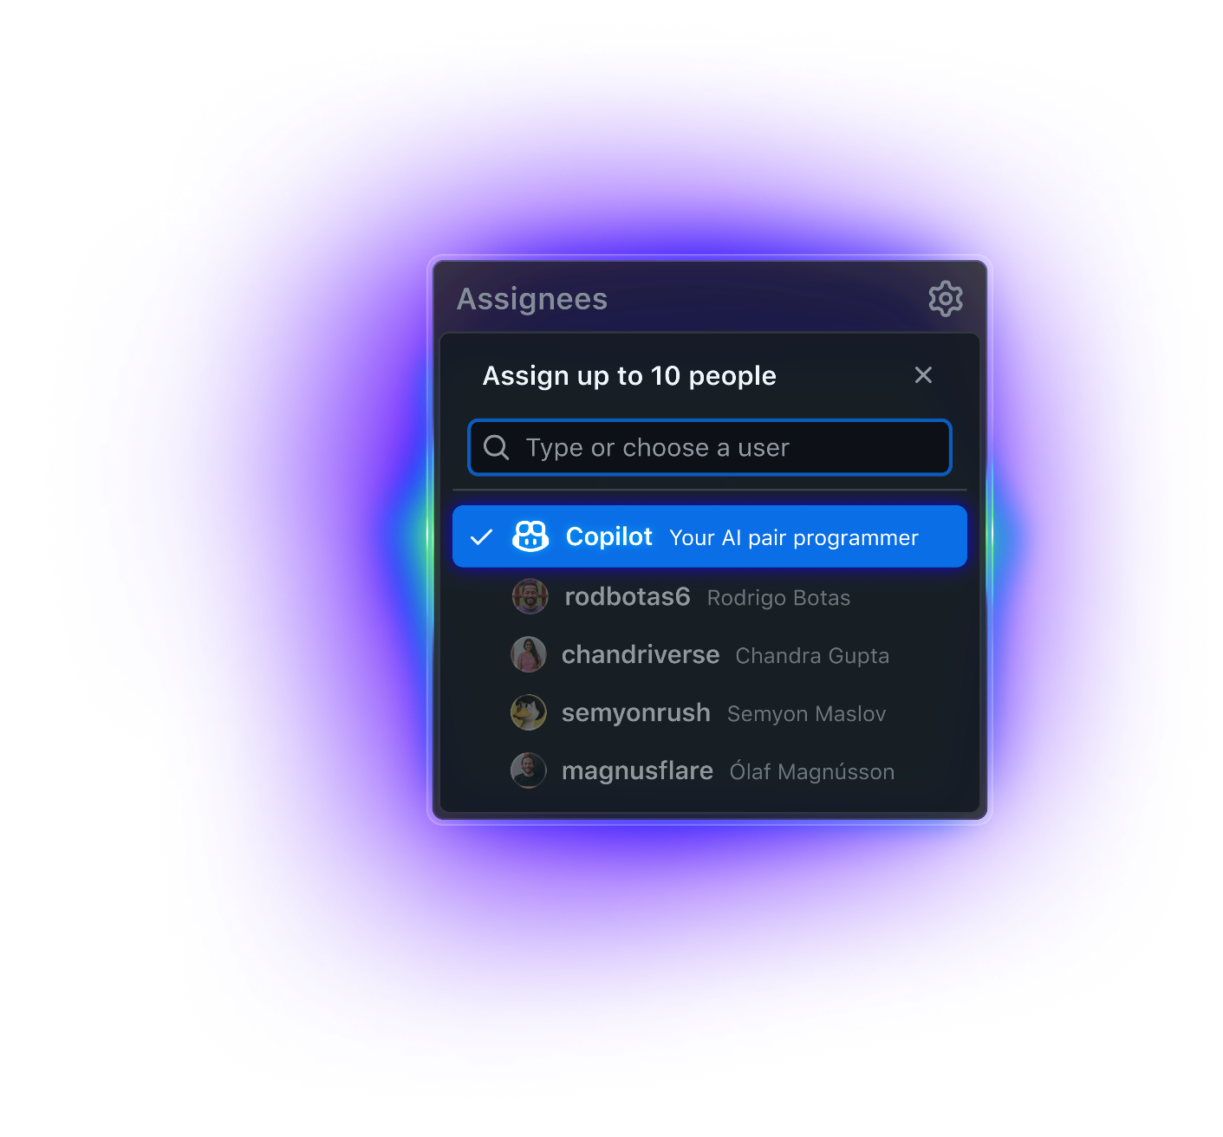

Code
Coding agent
Notes:
Now that you've seen quite a bit of how GitHub copilot enables developers to be super productive in their favorite ID or in the terminal it also is available as a cloud coding agent that works continuously for you any hour of the day in the cloud. We’re going to take a look at how the coding agent can be used and how it’s integrated into these different environments

Slide 4

Copilot works in the background
…while your developers focus on the most complex and high-value work
Building new features ✅
Fixing bugs ✅
Improving test coverage ✅
Addressing tech debt ✅
Improving documentation ✅
Notes:
Copilot coding agent is an asynchronous, autonomous coding agent that works in the background. and you might be thinking well when would I want to use the coding agent and why wouldn't I just do everything directly inside of my favorite IDE or code editor.
Well it works directly in the background and you can have multiple agents all running in parallel on different branches working and solving different problems yes they can be building new features but they might be triaging bugs improving test coverage addressing technical debt or even just improving documentation anytime you have a little idea or a big idea just give it to the coding agent and let it get to work

Slide 5
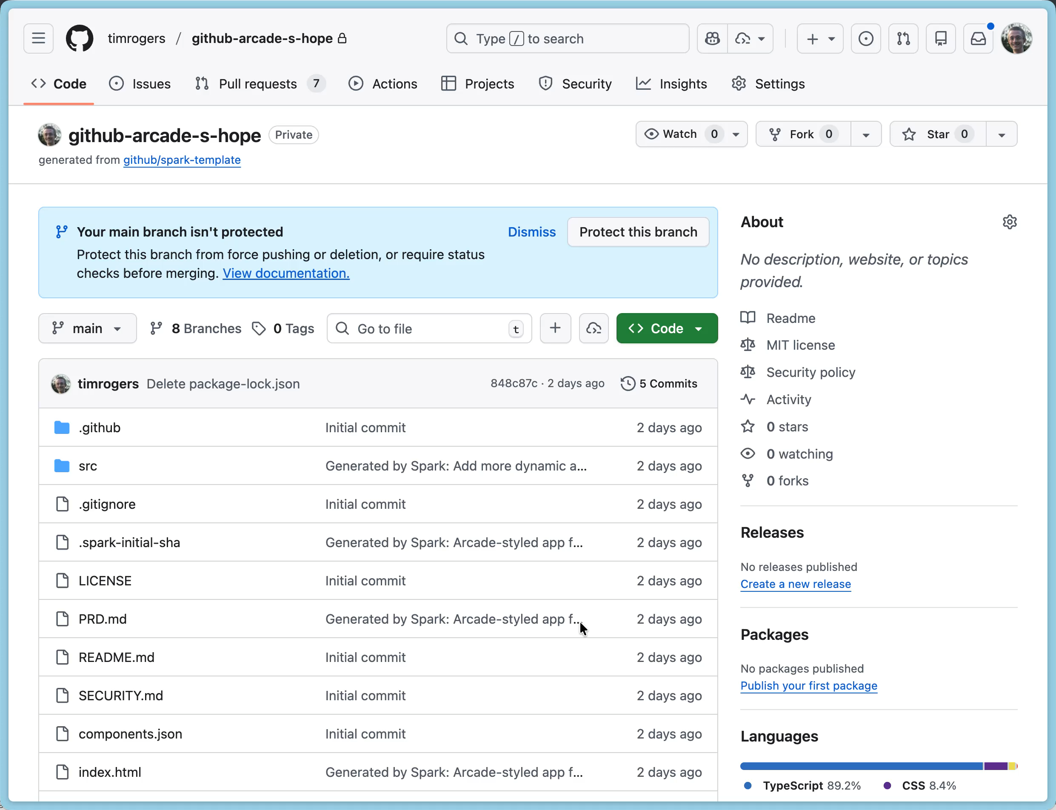
Notes:
There are a bunch of different ways to delegate tasks to Copilot – but let’s use the agents panel this time. The agents panel is a new UI, available on every page on GitHub. I open it up, and I can just type in a prompt, and send it to Copilot, and Copilot will start doing its thing.

Slide 6
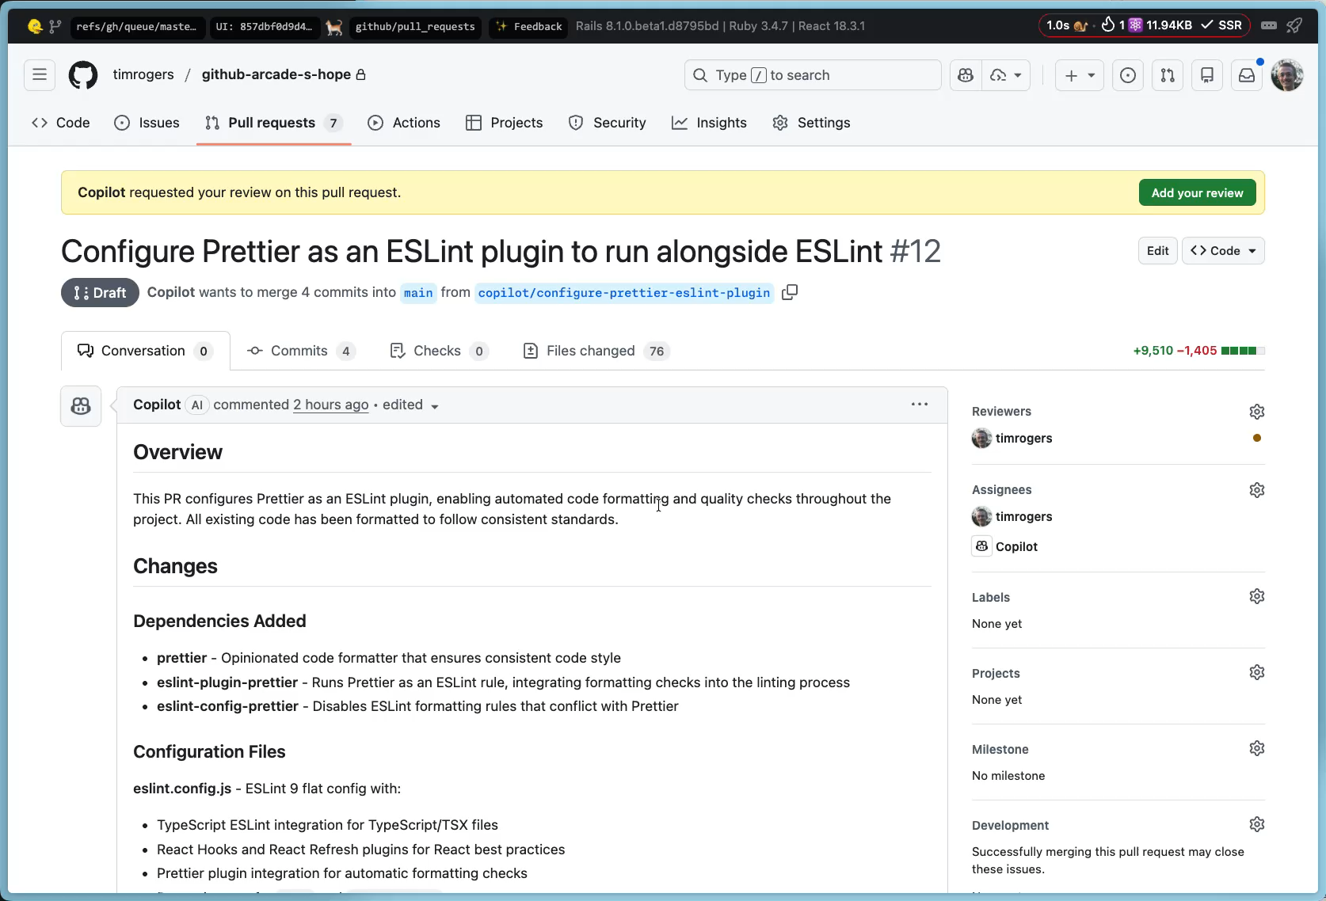
Notes:
Now I can see everything that the coding agent is doing directly here on GitHub. com or even inside of VS code, so once it's created the pull request I can come down and say view session I can also tap on the agents panel as well and that will bring me to all of my different agent sessions that are happening now the session is going to give me full overview of everything that’s happening inside of this coding session at anytime if I need to steer it or make changes I can just give it a prompt and it will go ahead and start to incorporate those changes in real time and it’ll even take screenshots and run things as well in the environment that’s fully customizable

Slide 7
Available wherever your team codes and collaborates
GitHub
GitHub Mobile
Delegate tasks to Copilot with the agents panel or assign an issue to Copilot
Hand tasks to Copilot to track progress while you’re on the move
GitHub CLI
IDEs
Kick off agents from your terminal with gh agent-task, and gh issue edit
Start background tasks without context switching from VS Code and JetBrains IDEs
Workplace chat apps
Project management tools
Collaborate with Copilot in Slack and Teams with a simple @mention
Assign issues to Copilot from Azure Boards, Jira (coming soon) and Linear
Notes:
This is the definitive control surface for the Hybrid Team: mission control. As agents become more autonomous, we eliminate the fragmented experience of managing them across different tools.
Your single destination for orchestrating and monitoring all agent work—whether it's the Copilot Coding Agent, a custom agent you built, or a third-party specialist.
We bring this unified experience to every part of your workflow:
On GitHub.com: A centralized view allows you to see all agent sessions in one place, check progress, and steer agents without losing context.
In the CLI & IDEs: Manage agent sessions directly from your terminal, allowing terminal-focused developers to monitor and script AI tasks without switching screens.
On Mobile: Track and manage Coding Agent tasks from your phone with real-time updates, ensuring you're never disconnected from your agent's work.
Project management tools and chat apps to delegate work easily.
This is how we ensure developers maintain full visibility and control as they delegate bigger, more complex workflows to their AI teammates.

Slide 8
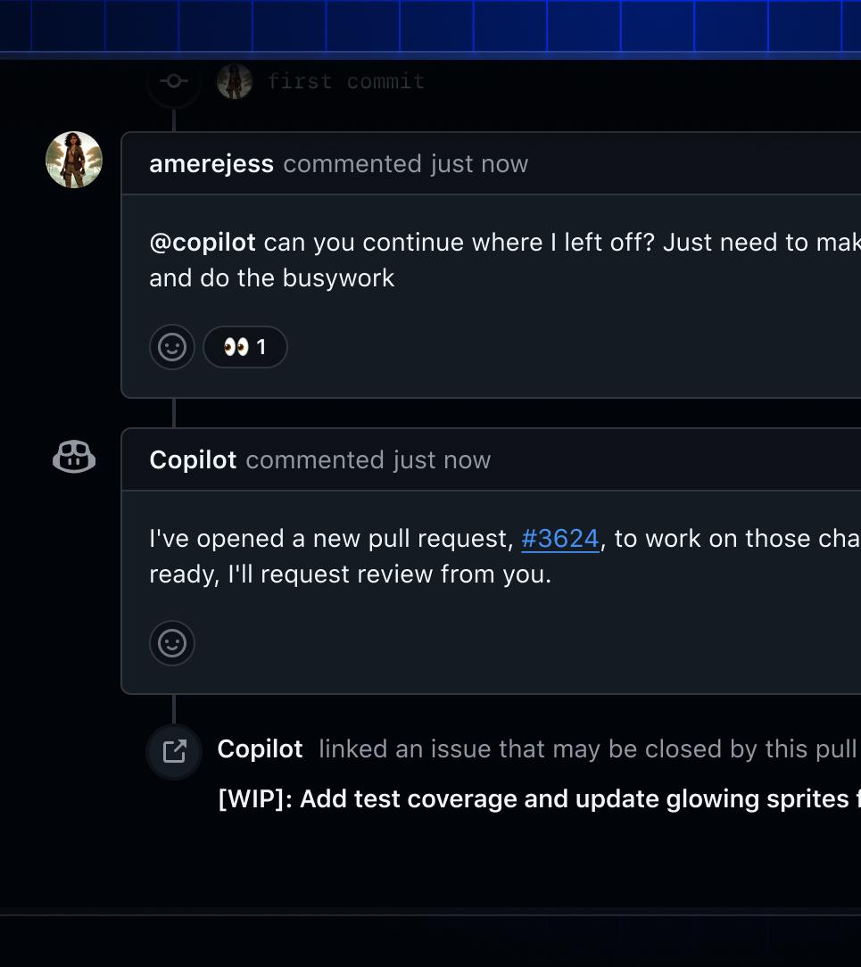
Ask Copilot to make changes to any PR
Copilot coding agent
Copilot is no longer limited to opening new PRs. Mention @copilot in an existing PR to have Copilot make changes.
Notes:
When you're working directly on GitHub.com the coding agent can work in a few ways first you can assign any issue to it and a pull request will be created or you can create and delegate a new task and optionally create a new pull request or have it just start work right away for review if you’re working in pull requests you can simply leave a comment with copilot and then it will go ahead and start to implement those changes.
another powerful feature is that if you’ve already created a pull request and you need additional work done just ask copilot to do it and it will create a new or request on top of your pull request and get to work

Slide 9
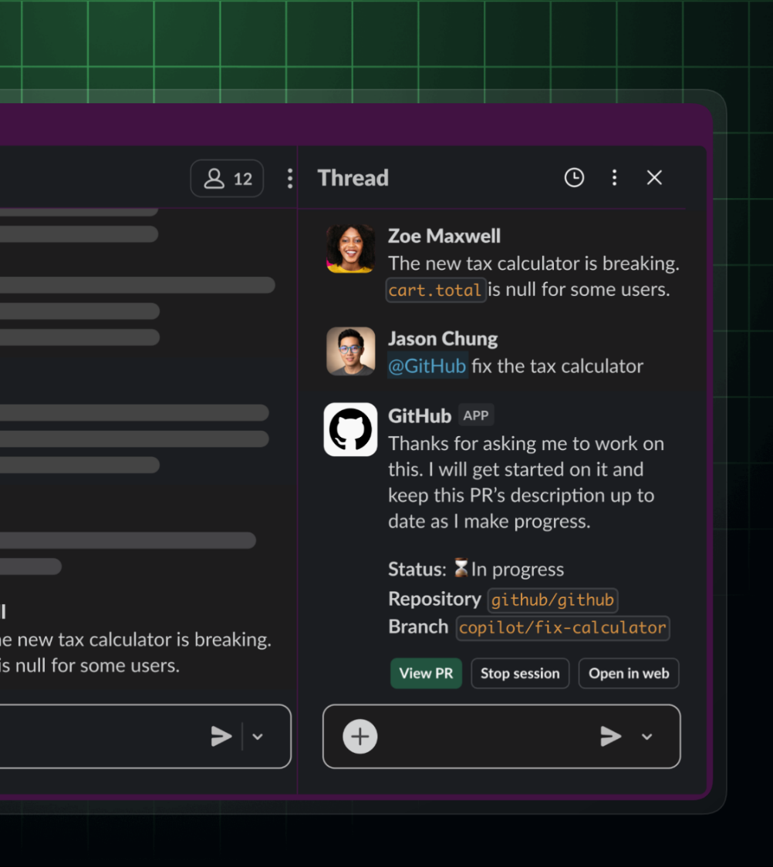
Start Copilot coding agent tasks from Teams or Slack
Slack integration
Go from collaboration to code without skipping a beat. Just mention @GitHub in any conversation.
Notes:
My team is in chat applications all the time and with the new GitHub extensions for teams and slack you can easily just mention @GitHub and you can query any information about your repos and also delegate work directly to it this is super nice especially if you have integrations directly into these different at tools that are reading in different bugs or feedback so you can easily assign things right away

Slide 10
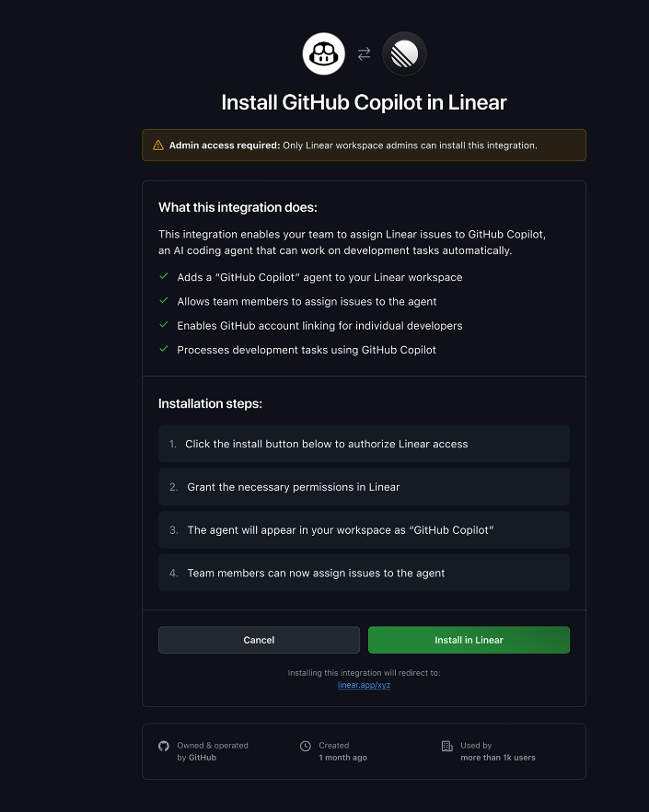
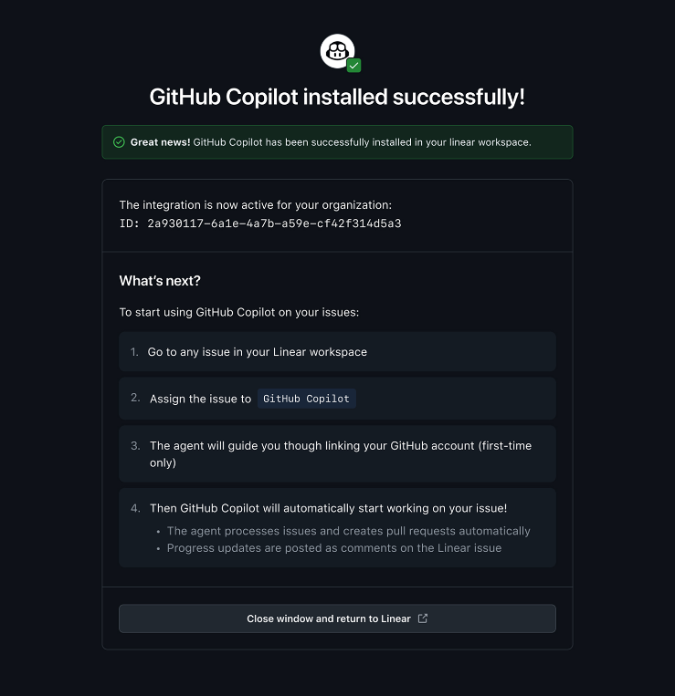
Assign Linear issues to Copilot
Linear integration
Hand Linear issues to Copilot in one click, with updates and logs streaming back to Linear
Notes:
This integration is a perfect example of how the Copilot Coding Agent is meeting developers where they work—specifically in the Plan phase.
The goal is simple: Eliminate the friction of context switching between planning and implementation.
When a new issue is created in Linear, developers can now assign the issue directly to GitHub Copilot.
The Copilot Coding Agent processes the issue description and acceptance criteria, then automatically begins the development work—creating a secure environment, writing code, and submitting a draft Pull Request to GitHub.
Crucially, progress updates and comments are posted directly back to the Linear issue, giving the project manager and team visibility without ever leaving the planning tool.
This integration eliminates the copy-paste workflow, creating a seamless flow from issue assignment to code implementation, ensuring the velocity of the Hybrid Team starts the moment the task is defined.

Slide 11
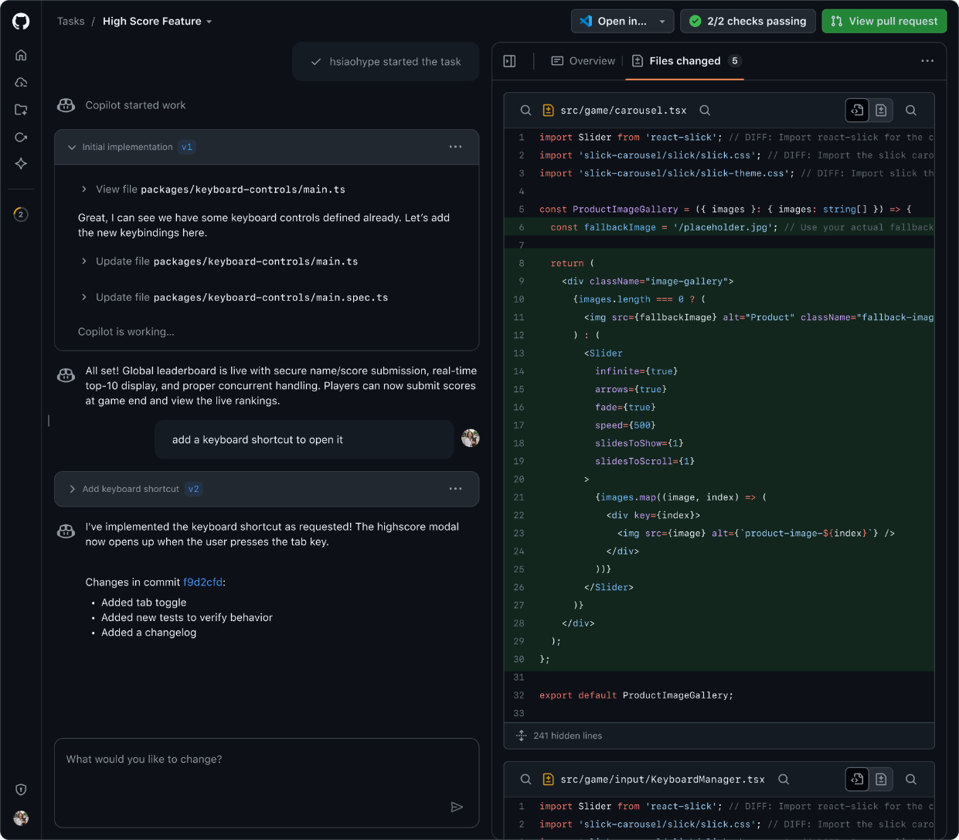
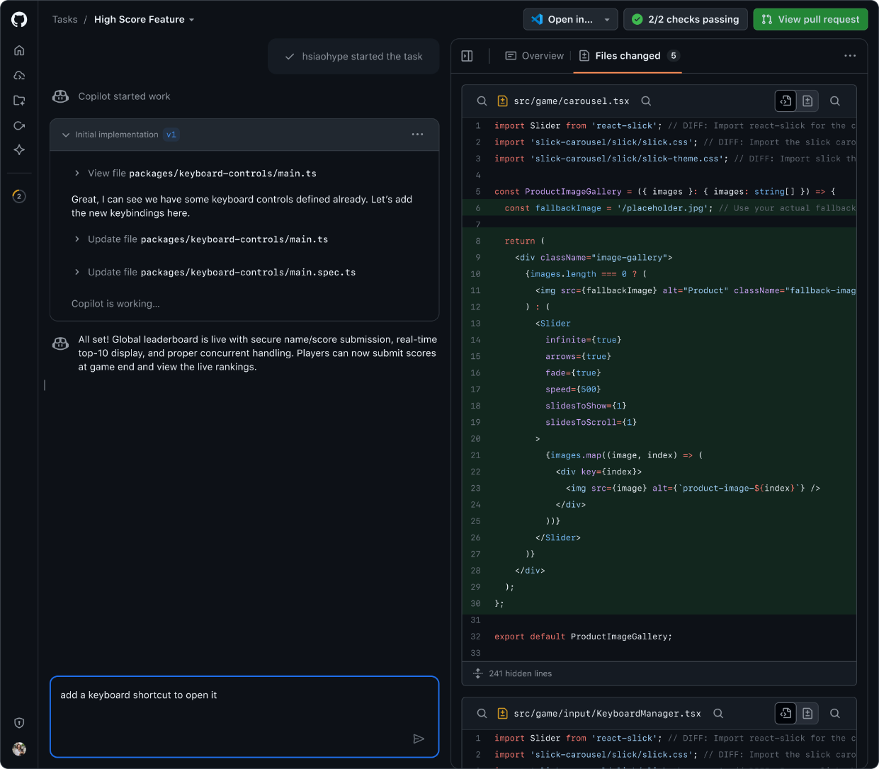
Manage, monitor, steer and review agent sessions, all in one place
Agent HQ
Jump between sessions, see what’s changed, track Copilot’s progress, and step in with course-corrections as needed.
Notes:
You'll often hear agents HQ or agent sessions and these are areas between the GitHub website and the various command line interfaces and ideas and code editors that enable you to easily jump between sessions guide steer so no matter where you're at all of your agents are together

Slide 12
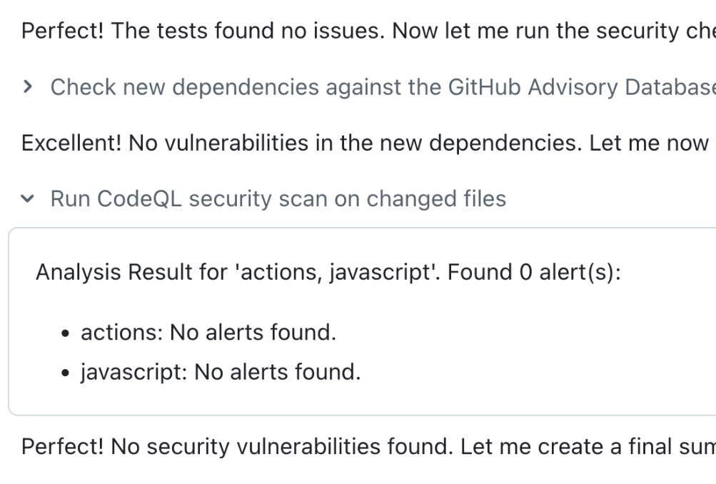
Stay secure while you move faster
Validation tools
Copilot checks its work automatically before asking for review, using the power of CodeQL, Secret Scanning, the GitHub Advisory Database and Copilot code review
Notes:
I also want to point out that part of the GitHub copilot coding agent is additional verification and security scans when changes are being made through the coding agent it will automatically do code reviews and secret scanning automatically using code QL and more

Slide 13
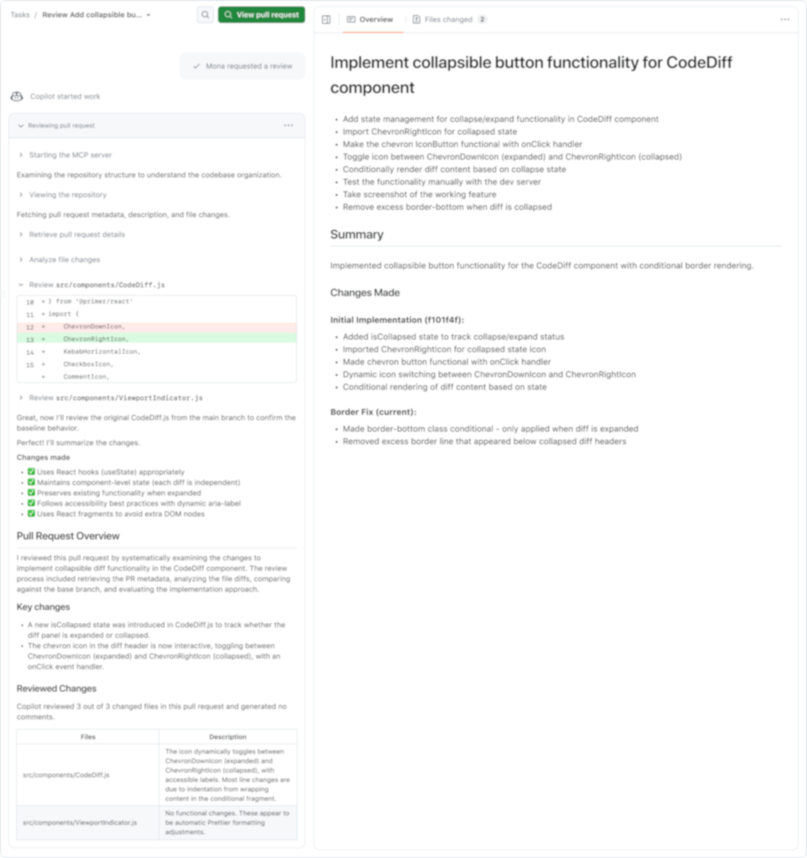
Have Copilot review code, then hand updates to coding agent for implementation
Copilot code review
Notes:
Copilot Code Review (CCR) is the agent that dramatically accelerates your Verify phase, ensuring faster reviews and higher code quality right at the Pull Request level.
CCR conducts thorough, context-aware reviews—not just looking for bugs, but applying the logic of human reviewer criteria like maintainability and team conventions.
It uses an Agentic architecture running on GitHub Actions, incorporating security findings from CodeQL and other security tools to deliver security-aware feedback that goes beyond simple style checks.
This is available in all major editors while you code, ensuring you get intelligent feedback at the moment you need it, not hours later when the PR is submitted.
The biggest acceleration comes from agent-to-agent quality review. When CCR identifies improvements, you can hand those suggestions directly to the Coding Agent to implement automatically.
This iterative self-improvement means human reviewers receive PRs that have already been through multiple refinement rounds, making reviews faster and focused only on high-level concerns.
This removes friction from the PR workflow by automating the repetitive tasks of responding to feedback, ensuring the result is faster reviews, better code quality, and sustained velocity.

Slide 14
Customizing coding agent
Notes:
Now there are a lot of different ways of customizing your agents and how they run so let's take a look

Slide 15
Customizing Copilot coding agent
Coding agent
copilot-instructions.md
copilot-setup-steps.yaml
Repository and organization level instructions that coding agent always considers
Customize the environment that coding agent runs in – install dependencies, configure access
MCP tools
Custom Agents
Configure MCP servers that Copilot can use to bring in outside context
Define a custom agent that is an expert in a specific area
Notes:
Automatically if your project is already using custom instructions like copilot instructions or agents files it will automatically be picked U by the coding agent and the same is true for custom agents but there are a few unique things as well such as custom setup steps to customize your environment so you can install dependencies and you can even configure MCP tools directly on the GitHub portal

Slide 16
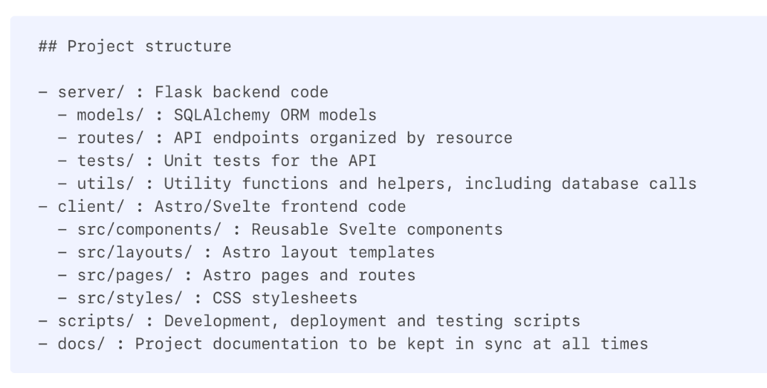
Create repository custom instructions files that give Copilot additional context .
copilot-instructions.md
Repository custom instructions let you provide Copilot with repository-specific guidance and preferences.
Notes:
We talked about it a little bit before but these copilot instructions or agent files are really important to help give additional context when the coding agent is working this will be read every single time the coding agent session starts and allows you to provide that additional context about repository specific guidance and references so things like the project structure or how you like your code architected and written do you prefer camel case this will all be considered when the file is loaded

Slide 17
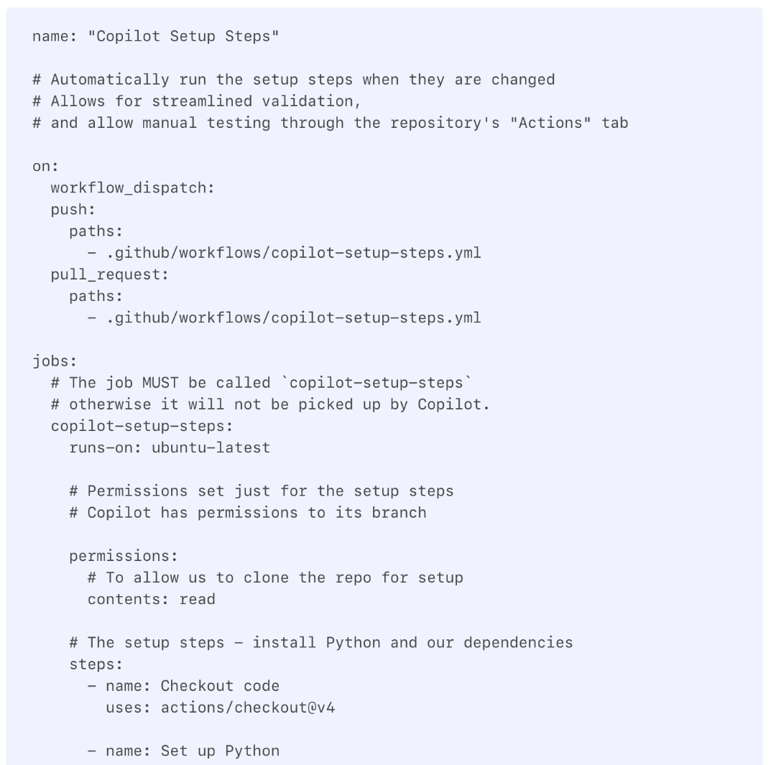
Configure Copilot’s environment with GitHub Actions
copilot-setup-steps.yml
You can preconfigure Copilot's environment before the agent starts by creating a special GitHub Actions workflow file, located at .github/workflows/copilot-setup-steps.yml within your repository.
Notes:
on your local development machine you've already set up all of your dependencies and any SDK's that you need now automatically the coding agent will use a Linux runner and you can customize the dependencies that are installed on that machine so for example if you have additional NPM requirements or for example I need a specific version of .net then you can make sure that that is inside of the copilot setup steps yaml file very similar to other workflows if you’re using GitHub actions

Slide 18
Configure MCP servers to access additional context
MCP Servers
Provide Copilot access to more tools, store tokens using environment secrets.
Notes:
to provide even more context while the coding agent is running MCP servers or model context protocol servers can be configured these are done on the website themselves because certain considerations need to be taken for authentication with MCP servers you can configure as many tools and even decide what tools are available to the coding agent and you can use environment secrets for tokens

Slide 19
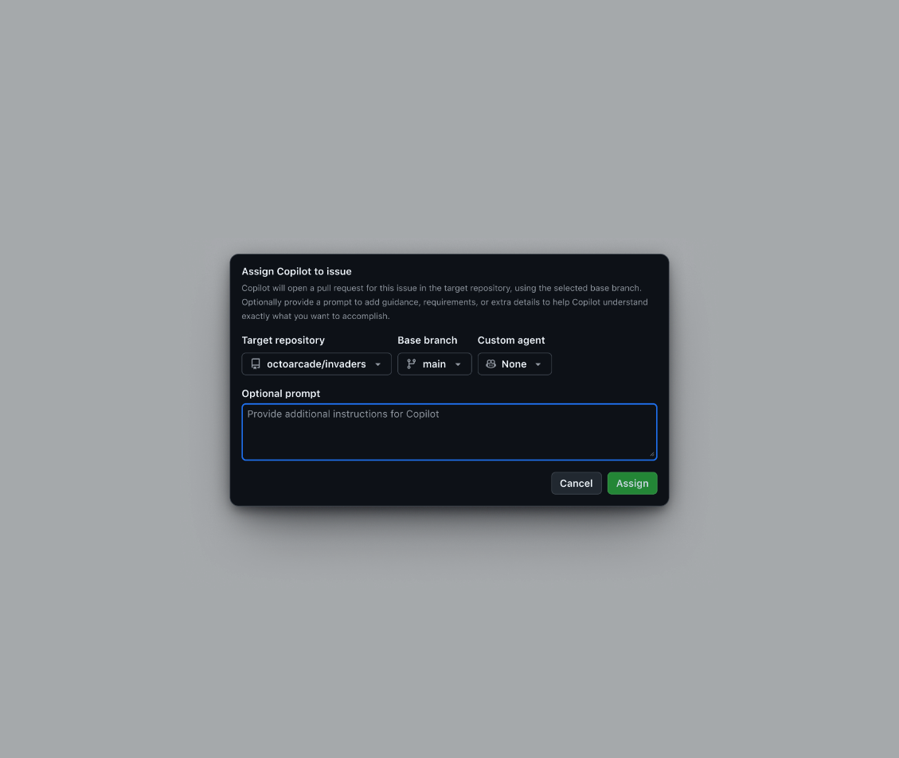
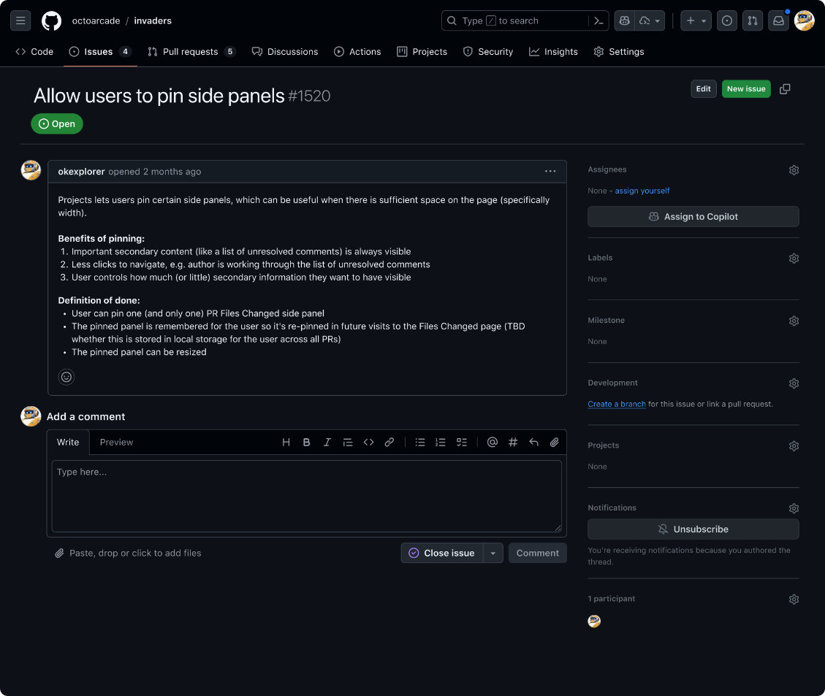
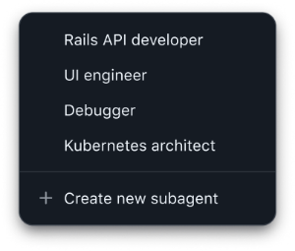
Reduce repetitive prompting by creating specialized agents to target recurring tasks
Custom agents
Equipped with tailored prompts, tool sets, and MCP server connections, you can implement features or fix bugs without needing to configure every time
Notes:
Custom Agents allow developers to create specialized AI personas that are optimized for specific types of development work.
When you use a general-purpose agent for tasks like "Rails API developer" or "Kubernetes architect" (as seen in the screenshot), you often waste time crafting long prompts.
Custom Agents eliminate this repetitive work by specializing in specific problems with tailored prompts, curated toolsets, and MCP server connections already configured.
This specialization creates higher quality output from the start, as the agent already knows the necessary context and conventions for that specific job.
This feature allows you to define and share agents across your organization—at the repository, organization, or enterprise level.
Teams can capture their specific configurations, security standards, and coding conventions into a custom agent, distributing that expertise so that every developer benefits without having to build their own from scratch.
For the enterprise, this is key to controlling agent sprawl and ensuring that agents used by developers are selected from a set of approved subagents defined within your enterprise guardrails.

Slide 20







Partner-Built Custom Agents
Specialize your Copilot Coding Agent

Slide 21
Demo

Slide 22
Code
Coding agent
Notes:
And that's the GitHub copilot coding agent available for you anytime of the day to help delegate tasks to the cloud no matter where you’re working from

Slide 23


GitHub Copilot Dev Days Sweepstake
All completed surveys are eligible for our sweepstakes to win a GitHub Copilot Pro+ one-year subscription.
https://aka.ms/githubcopilotdevdays/sweepstakes

Slide 24
Thank you

